Slide 1

Ethical Hacking Presentation
Presented by - Noel Varghese

Slide 2
Windows Access Control
From the terminology itself,one can understand that it is an application or some mechanism,that controls access to a process or service,from those wanting to use it.
Windows Access Control simply verifies credentials of entity asking for a process,by handling the entity’s request
It is prevalent in all systems imbibing Windows OS
Access control is set for a file,document or system processes.
For a file->Select ‘properties’ tab,from right clicking a file.Current user,if having admin privileges can set permissions on who can edit or read the file.
For system processes->Visit the System & Security sub-option,under ‘Control Panel’.User Access Control is configured from here

Slide 3
Usability and objectives
Unlike Linux,where permissions are set in CLI mode,Windows follows GUI mode,for the same purpose.
Why is it required?
To fulfil the requirements of CIA Triad,in a computer system,that stays authentic and un-compromised,to the user that is using it.
System was developed in 2000,with the implementation of Active Directories.These are further broken down to groups.

Slide 4
How to implement the model?
To make use of the model,techniques are used:-
Access Token-Whenever a user logs on to a computer,using the correct credentials,he/she is armed
To make use of the massigned a token,that contains information about the current user,including other metadata.
That token is verified by the ACM,when the user is trying to access a service.This may cause the spawning of a prompt.In this step,the access token of the requesting user is verified(authorized and authenticated).

Slide 5
More Techniques
Security Descriptor-Any service may be known distinctly by their name,characteristics etc.This information is received by the user trying to access a particular service.
The information also include:-
An unique SID, SACL and DACL
A SD uses the SD Definition Language and also contains strings.They include:-
Owner. Group and Trustee of ACE

Slide 6
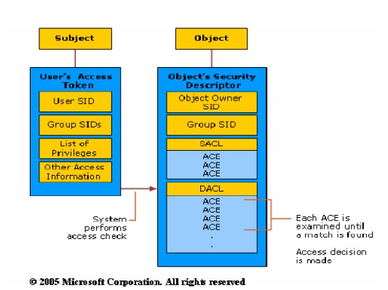
Security Identifier-It is a numerical representation of a service.Each service is handed a unique ID and is referenced by the ID.
Access Control Lists:-These lists contain the users authorized by the system administrator to use services.Each service has an ACL associated with it.Prior to request approval and,a check is made through the ACL.
ACL can be of two types:-
Dynamic and System

Slide 7
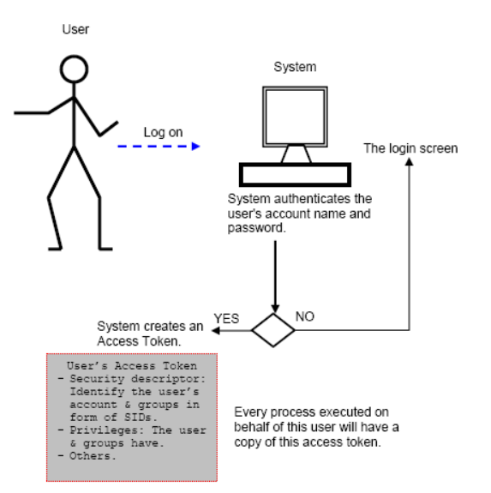
Decision Flowchart of the Access Control Model

Slide 8
Privilege Escalation
For example,any entity holding control over device drivers can assume control over the entire system.
This is done in particular by checking the DACL
Access is granted or denied,based on the SeLoad Driver Privilege

Slide 9
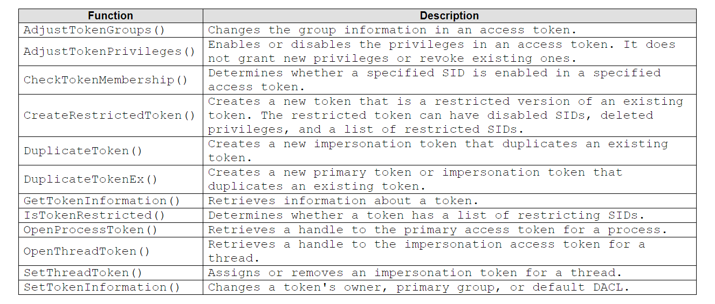
Functions associated with Security Access Model

Slide 10

Fuzzing-An Introduction
It is the process of deliberately inserting incorrect or undesirable input,into a program or application,to discover possible bugs and vulnerabilities
An application may not be prone to fuzzing,if it has a whitelist, learns to recognize bad input and does not show undesirable behaviour.
Types of fuzzers-Protocol,mutation and generation based

Slide 11
Sulley Fuzzing Framework
This framework performs fuzzing,in an automated manner.
It is able to sling packets for fuzzing,efficiently through a network
Sulley was authored by two renowned security researchers, Pedram AMINI and Aaron Portnoy.
Being a python based tool,it is compatible on both Windows and Linux
It can be used to fuzz file formats, network protocols, command line arguments, and other codes.
It plays a role in pentesting,software development life cycle and bug bounty

Slide 12
Features of the Framework
Sulley watches the network and methodically maintains records.
Sulley instruments and monitors the health of the target, capable of reverting to a known good state using multiple methods.
Sulley detects, tracks and categorizes detected faults. Sulley can fuzz in parallel, significantly increasing test speed.
Sulley can automatically determine what unique sequence of test cases trigger faults.
Sulley fuzzers start simple and don’t have messy syntax
Can handle challenge-response and prev-packet-length situations
Effective and reliable

Slide 13
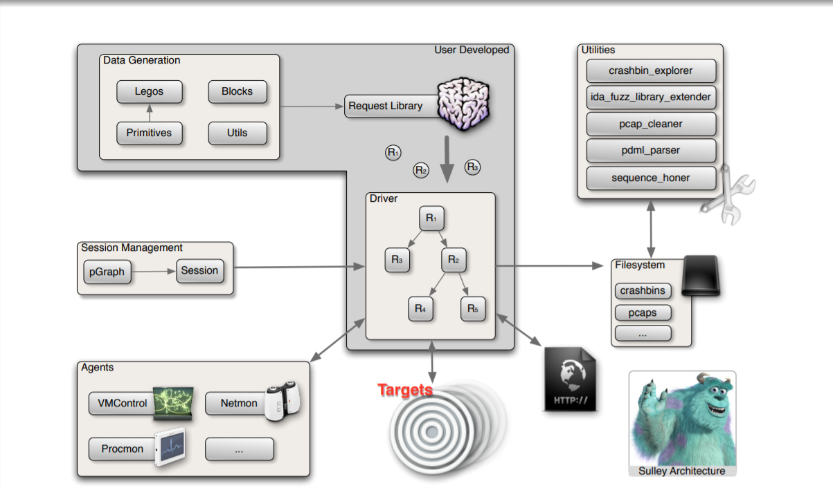
Sulley Framework Architecture

Slide 14
Components of the Framework
Data Generation You build requests out of primitives and legos Legos are complex types that extend the framework
Session Management / Driver Requests are chained together in a graph to form a session The session class exposes a standalone web interface for monitoring and control The driver ties targets, agents and requests together
Agents Interface with the target for instrumentation and logging purposes
Utilities Standalone command line utilities that perform a variety of tasks

Slide 15
Libraries and dependencies required by Sulley
ctypes: provides C compatible data types and allows calling functions in DLLs or shared libraries.
pydot: facilitates easy creation of both directed and undirected graphs from Python.
wxPython: GUI toolkit for Windows and Unix with native look and feel on each platform.
MySQLdb: a thread-compatible interface to the popular MySQL database server that provides the Python database API.
GraphViz: can be used to produce both directed and undirected graphs.
Oreas GDE: provides a mechanism for editing and automatically laying out diagrams, which are represented in form of graphs and cluster graphs.
uDraw: automates the task of creating flowcharts, diagrams, etc
pcapy: a python library that knows how to capture packets
.

Slide 16
References:-
https://www.installsetupconfig.com/win32programming/accesscontrollistacl1.html
https://docs.microsoft.com/en-us/windows/win32/secauthz/sid-strings
https://www.slideshare.net/ayousif/yousif5520project
https://www.guru99.com/fuzz-testing.html
https://fuzzinginfo.files.wordpress.com/2012/05/introducing_sulley.pdf
https://github.com/OpenRCE/sulley
https://resources.infosecinstitute.com/topic/sulley-fuzzing/
https://resources.infosecinstitute.com/topic/sulley-fuzzing/
https://www.youtube.com/watch?v=6sooEScW07Y
https://www.exploit-db.com/docs/english/25717-fuzzing-an-introduction-to-sulley-framework.pdf

